Slide 1

Visualizing Music Venues in Toronto’s Boroughs
JR Patton

Slide 2
Introduction
Problem Description
This presentiation will explore the problem of a musician or music lover moving to the Toronto area who is attempting to determine which area (borough) would best give them access to music venues. We will take into account not only venues that exist in the borough but also their average rating to weight the score.
Given this information we will plot the boroughs with a color scale to show which areas may be more appealing to move to.
Data Description
List of postal codes of Canada: M
Foursqare API
Geocoder API

Slide 3
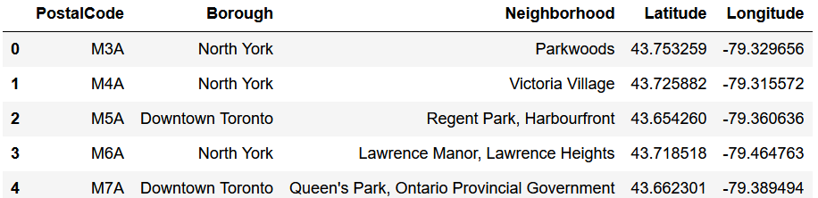
Data
Pandas Dataframe shown below

Slide 4
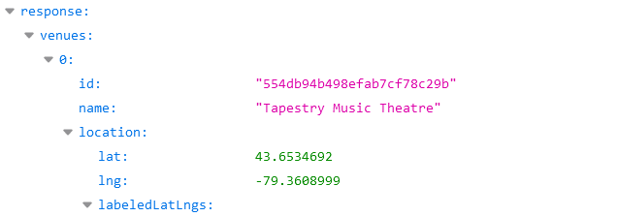
Foursquare API
Foursquare API was leveraged to query nearby live music locations
These were scored based on the following criteria
1 points: venue has an average Foursquare rating less than 4
2 points: venue has an average Foursquare rating between 4 and 6.5 or has no rating
3 points: venue has an average Foursquare rating between 6.5 and 8.5
4 points: venue has an average Foursquare rating greater than 8.5

Slide 5
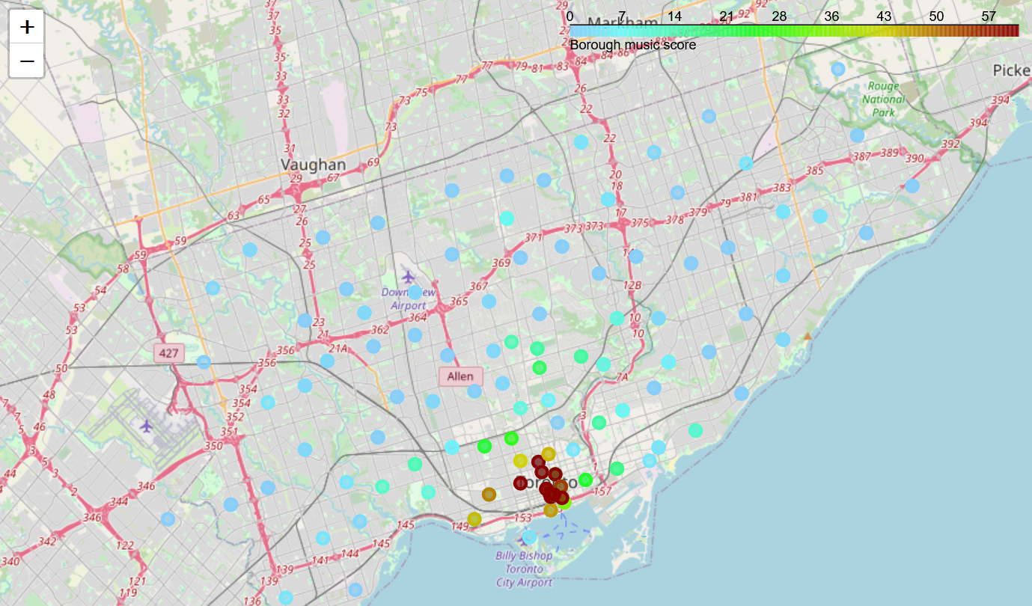
Folium Map
Map was marked with postal codes highlighted and colored based on music score
From the map, we can see that the area in Downtown Toronto has the highest density of well rated music venues

